Slide 1


Slide 2
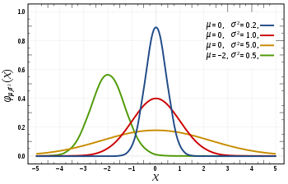
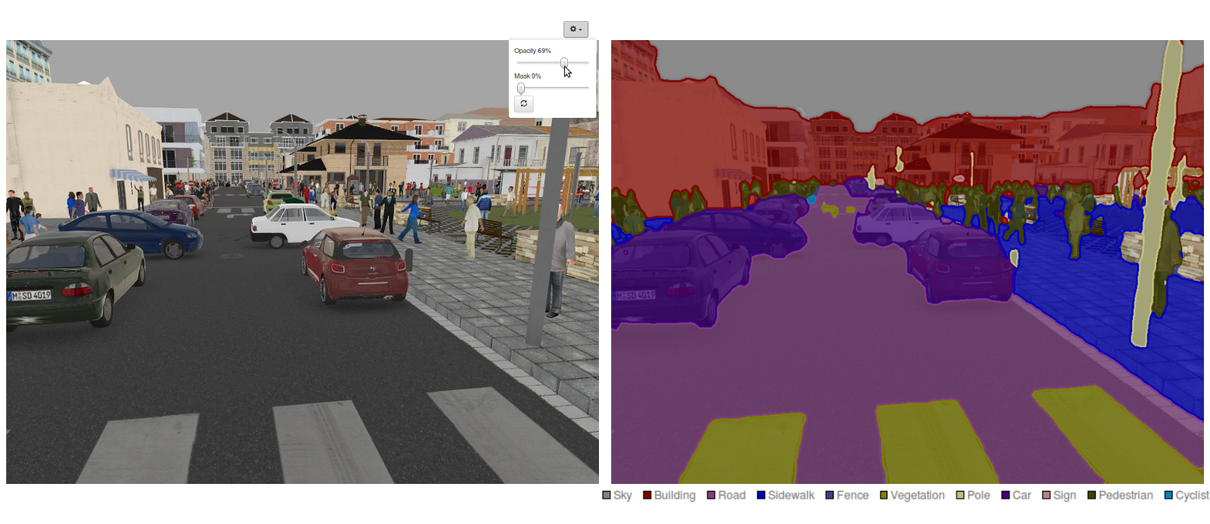
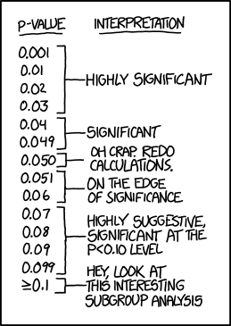
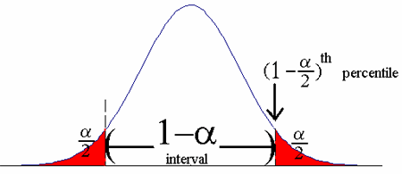
Input
Model(s)
Output
Introspection

Slide 3
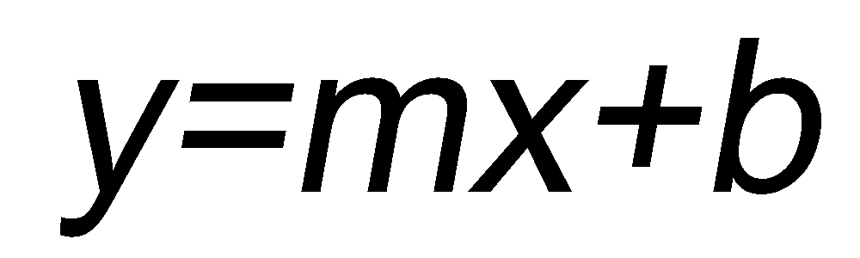
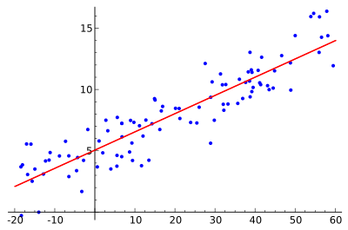
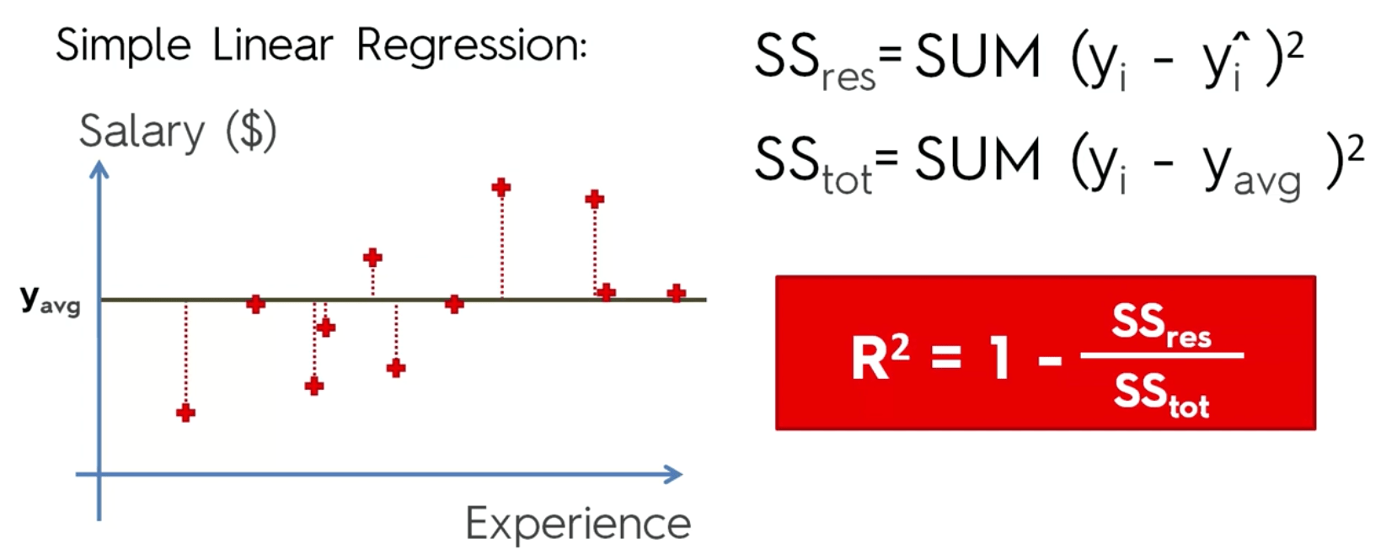
Input
Model(s)
Output
Introspection
Notes:
Turns out linear regression equation is super powerful, but not for the reason we think.

Slide 4
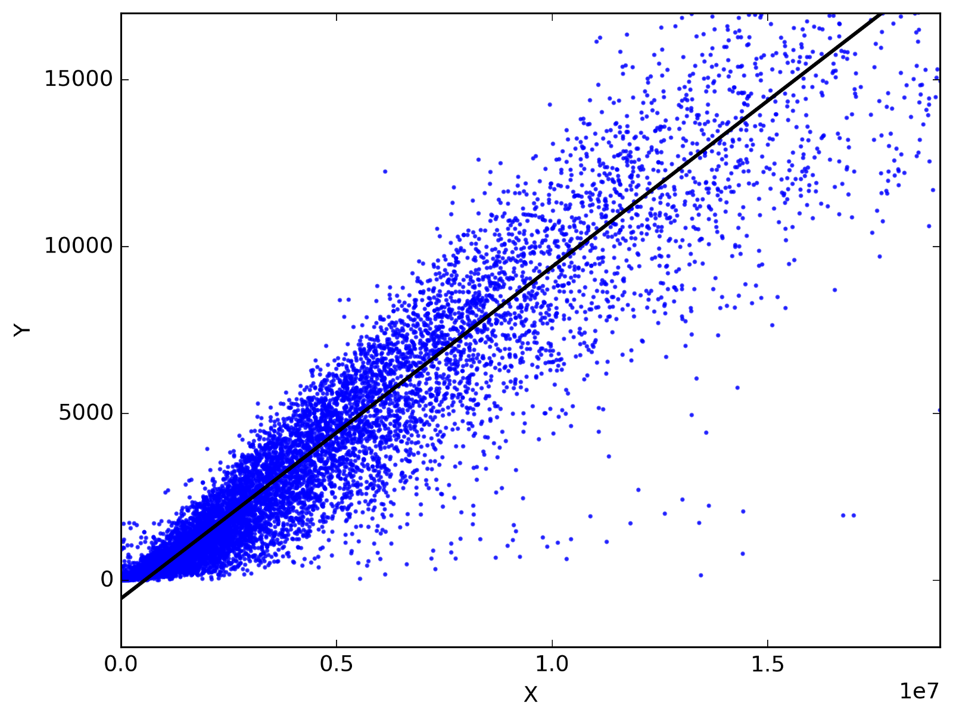
Linear Regression is boring
Only should work with problems that are linear. (Obviously)
Are linear things really that common?
Or do we just notice them because it is difficult to explain anything else?
We can pretend its more fun and go forward.

Slide 5
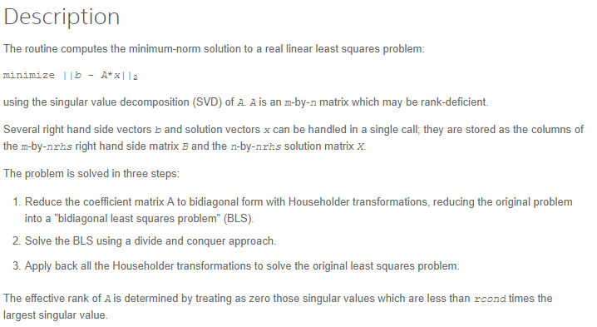
How does the scikit learn LinearRegression Object work?
Well it doesn’t really matter.
https://software.intel.com/en-us/mkl-developer-reference-c-gelsd
https://software.intel.com/en-us/mkl-developer-reference-c-gelsy
Uses algorithms which do matrix inverse operations.

Slide 6
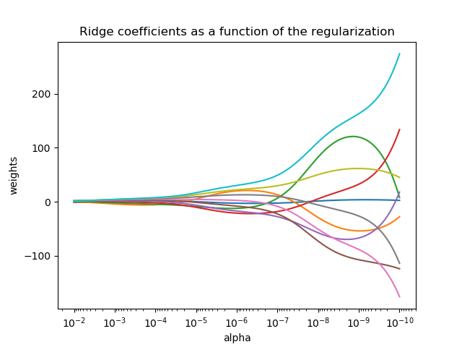
Linear Regression Derivatives
http://scikit-learn.org/stable/modules/linear_model.html
Ridge Regression
Lasso
Elastic Net

